Slide 1
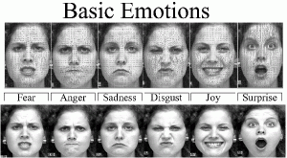
FACIAL EMOTION RECOGNITION
Group 25: Ashwin Unnikrishnan, Abhishek Chandra, Shamekh Siddiqui

Slide 2

PROBLEM STATEMENT
The ability to recognize emotional facial expressions is essential for good interpersonal communication.
Facial Emotion Recognition has plenty of uses cases like
Smarter border control for screening
Healthcare – Prioritizing patients
Marketing – Analyzing focus groups
Alerting drivers
Implemented CNN models to tackle this issue with comparison analysis
On the frontend side, we have implemented a live image classification model based on ResNet.
Notes:
https://anyconnect.com/blog/facial-recognition-applications/
https://www.itbusinessedge.com/business-intelligence/value-emotion-recognition-technology/

Slide 3
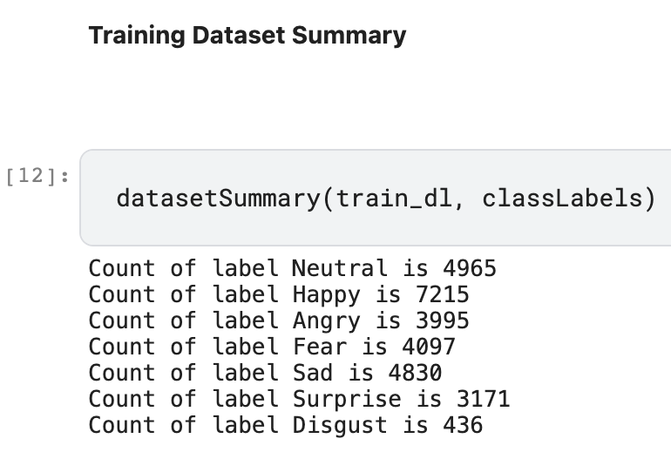
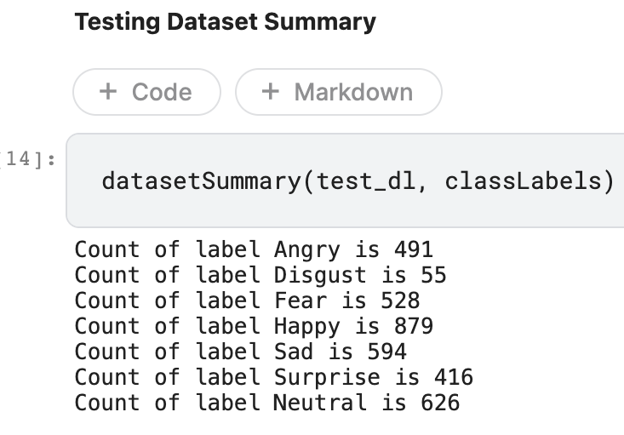
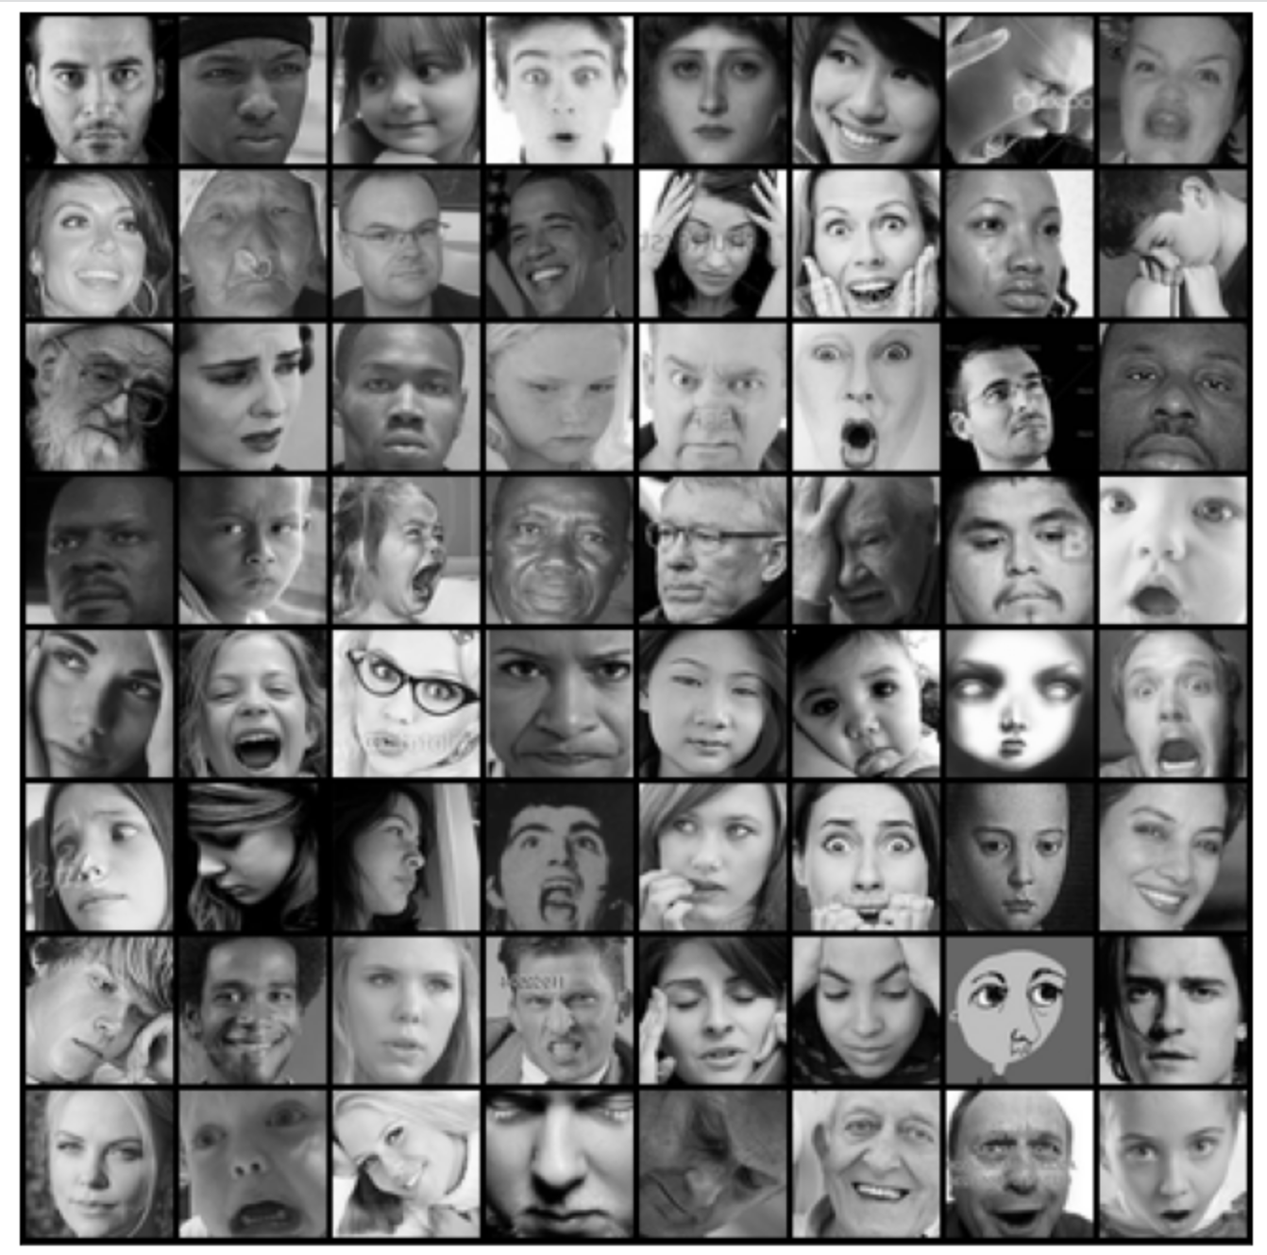
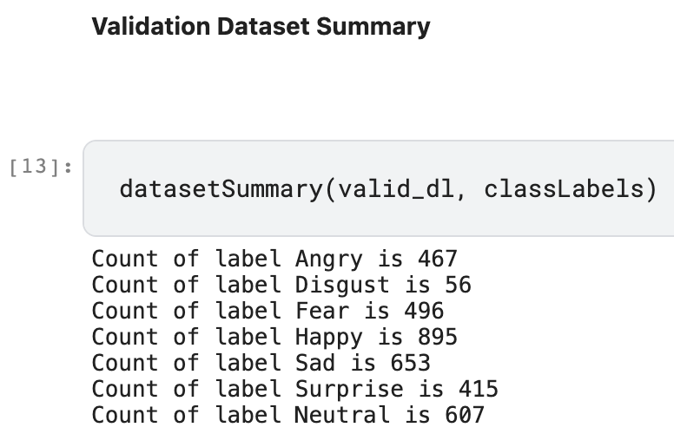
Dataset
This FER2013 kaggle dataset contains images with 7 labels categories:
{Angry, Fear, Disgust, Sad, Neutral, Surprise, Happy}}
The images are 48x48(width, height) grayscale images, a sample batch shown.
Preprocessing: horizontal flipping, reshape, normalizing, feature embeddings (toTensor)
Live Video Data transformation includes:
capturing video stream and reshaping into cropped images of size 48x48
converting into grayscale
Training Dataset Summary
Testing Dataset Summary
Sample Batch (64)
Validation Dataset Summary

Slide 4
MODELS
LeNet
First CNN model developed to classify handwritten digits, hence suitable for 7 labels classification. It uses Relu as the activation layers.
As our input is 48x48 we have used 3 Layered LeNet with two convolution layers followed by 1 fully connected layer. (large resolution issue)
AlexNet
Deeper than LeNet, with more filters per layer, and with stacked convolutional layers. It consisted 11x11, 5x5,3x3 convolutions.
It deals with overfitting by using "dropout" rather than regularisation. Accepts 224x224, so we upscaled the image from 48x48 to the respective size.
VGG
Instead of using large receptive fields like AlexNet (11x11 with a stride of 4), VGG uses very small receptive fields (3x3 with a stride of 1).
Because there are now three ReLU units instead of just one, the decision function is more discriminative
RESNET
As we make the CNN deeper, the derivative when back-propagating to the initial layers becomes almost insignificant in value.
As a result the ResNet was developed to resolve the vanishing gradient problem. With ResNets, the gradients can flow directly through skip connections backwards from later layers to the initial filters.
 | LeNet | AlexNet | VGG | ResNet
Layers | 3 | 5 | 11 | 9
Learning Rate | 0.01 | 0.01 | 0.05 (Decaying) | 0.001(OneCycleLR)
Epochs | 50 | 50 | 50 | 50
Batch Size | 32 | 64 | 64 | 64
Optimizer | SGD | Adam | SGD | Adam, SGD
Loss Function | CrossEntropy | CrossEntropy | CrossEntropy | CrossEntropy
Notes:
Talk about Variable Learning rate of Residue Network. Learning rate scheduling: Instead of using a fixed learning rate, we will use a learning rate scheduler, which will change the learning rate after every batch of training. There are many strategies for varying the learning rate during training, and the one we’ll use is called the “One Cycle Learning Rate Policy”, which involves starting with a low learning rate, gradually increasing it batch-by-batch to a high learning rate for about 30% of epochs, then gradually decreasing it to a very low value for the remaining epochs.
Weight decay: We also use weight decay, which is a regularization technique which prevents the weights from becoming too large by adding an additional term to the loss function.

Slide 5
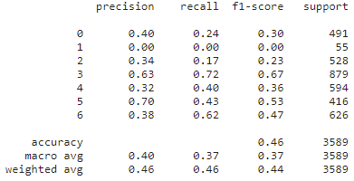
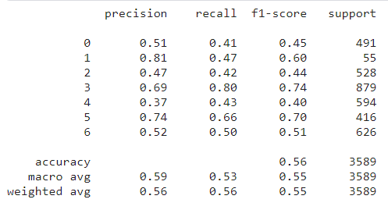
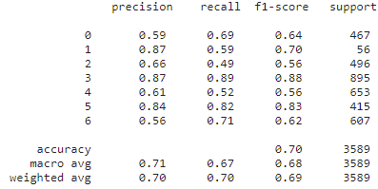
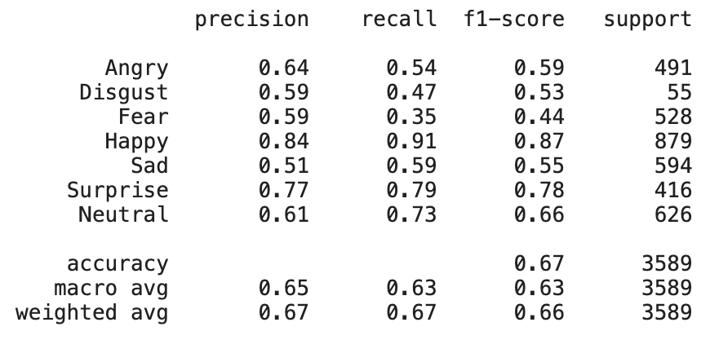
Results & Conclusion
LeNet
AlexNet
VGG
ResNet
Test accuracy: 46%
Test accuracy: 56%
Test accuracy: 70%
Test accuracy: 67%

Slide 6
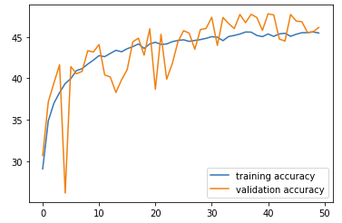
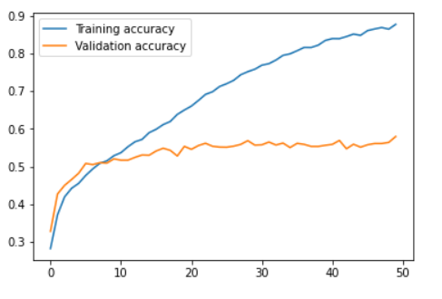
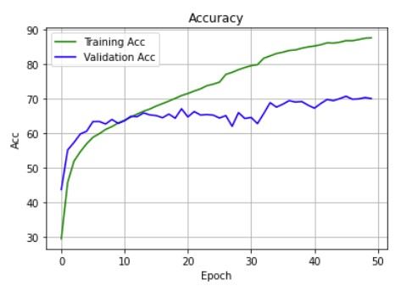
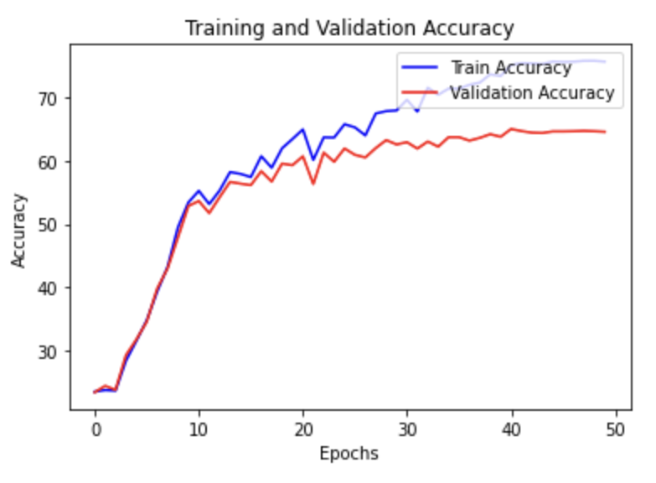
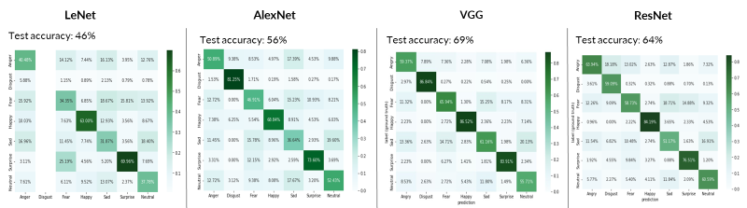
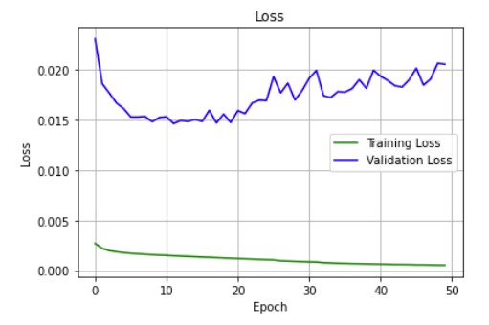
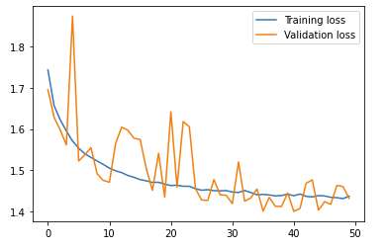
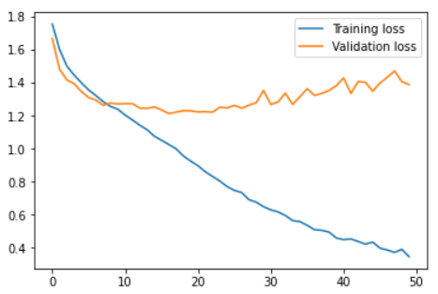
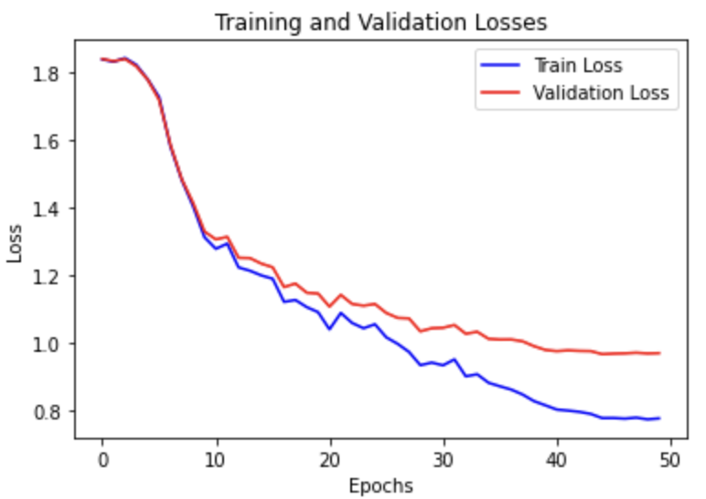
Results & Conclusion
LeNet
AlexNet
Vgg
ResNet
Accuracy
Accuracy
Epoch
Epoch
loss
loss
Epoch
Epoch

Slide 7
 | LeNet | AlexNet | VGG | ResNet
Training Accuracy | 44% | 89% | 87% | 72%
Validation Accuracy | 46% | 58% | 70% | 65%
Testing Accuracy | 46% | 56% | 70% | 67%
Precision | 0.40 | 0.59 | 0.71 | 0.65
Recall | 0.37 | 0.53 | 0.67 | 0.63
F1-Score | 0.37 | 0.55 | 0.68 | 0.63

Slide 8
Results & Conclusion
LeNet
AlexNet
Vgg
ResNet
Accuracy
Accuracy
Epoch
Epoch
loss
loss
Epoch
Epoch

Slide 9
Results & Conclusion
LeNet
AlexNet
Vgg
ResNet
Accuracy
Accuracy
Epoch
Epoch
loss
loss
Epoch
Epoch

Slide 10
Results & Conclusion
LeNet
AlexNet
Vgg
ResNet
Accuracy
Accuracy
Epoch
Epoch
loss
loss
Epoch
Epoch

Slide 11
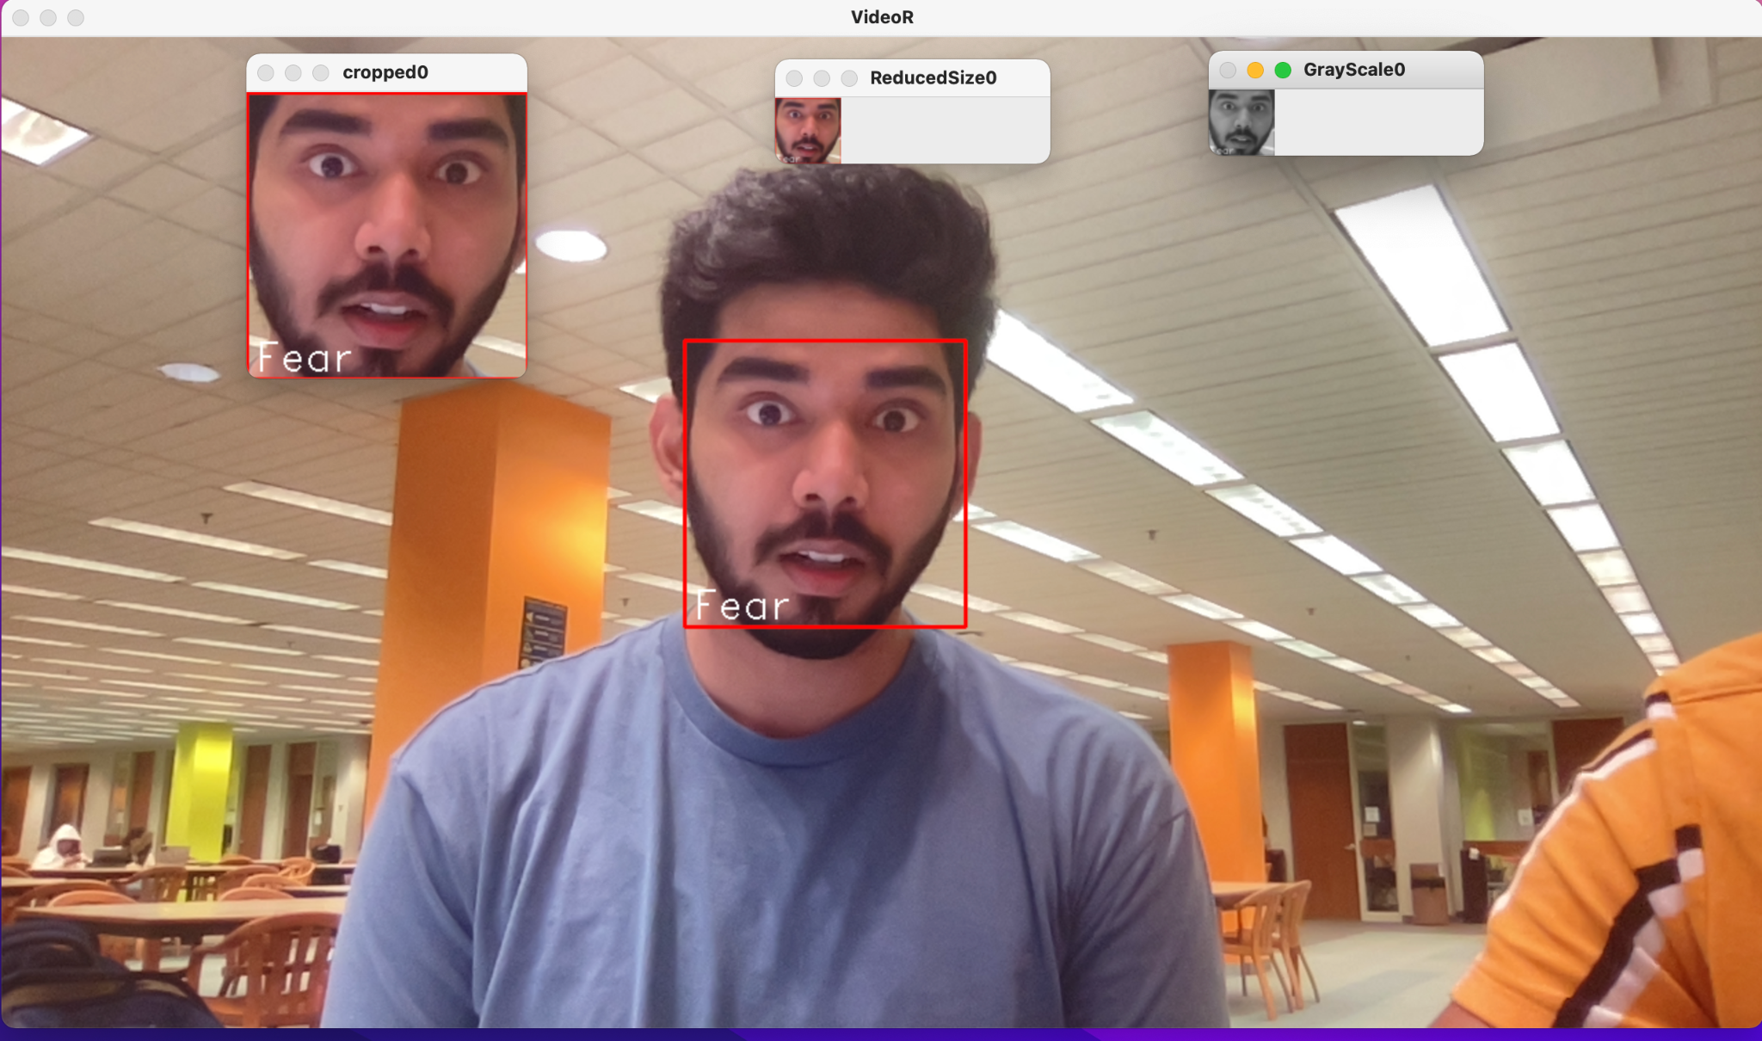
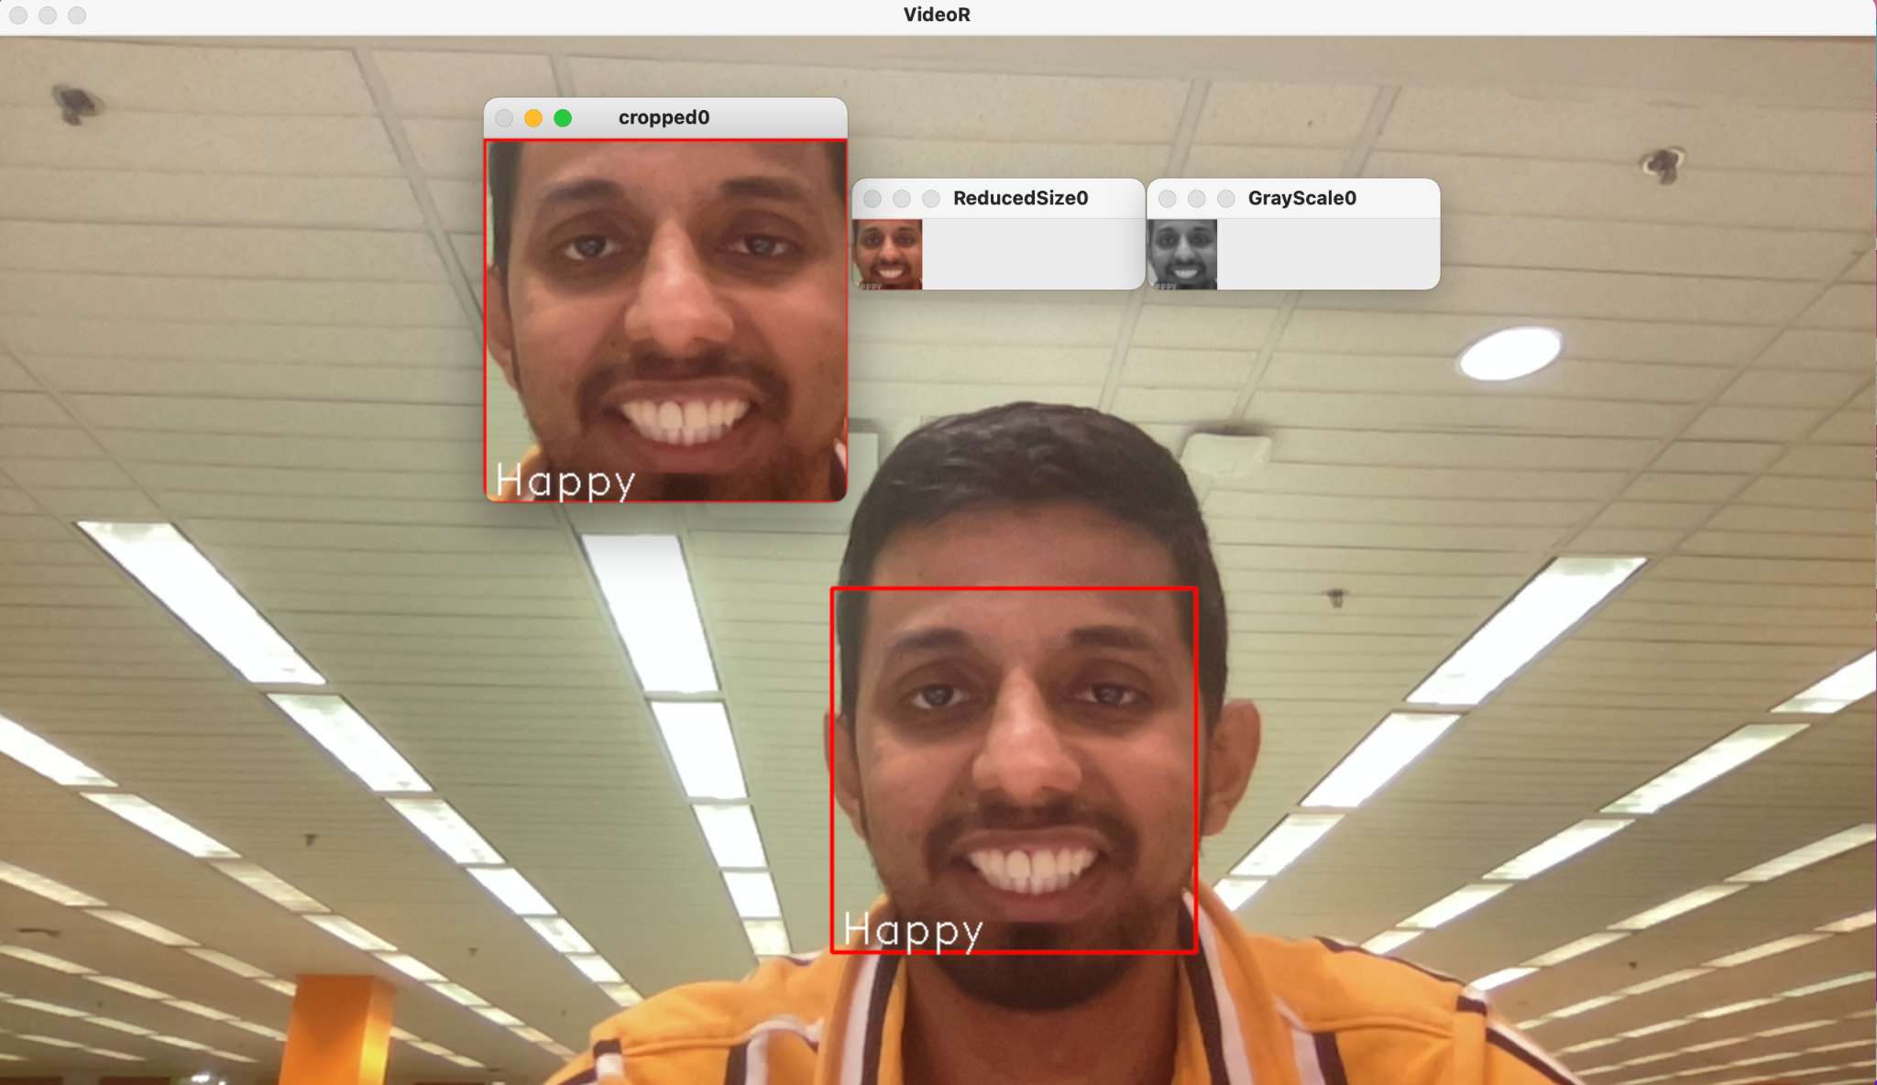
Live Video Transformation

Slide 12
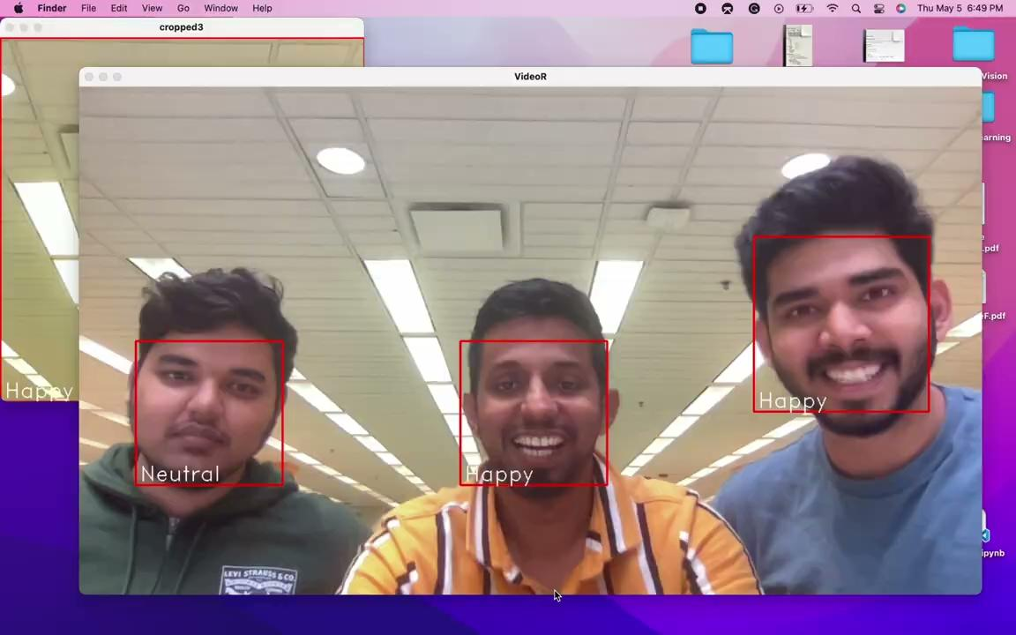
Live Facial Expression Detection

Slide 13
THANK YOU

